Slide 1
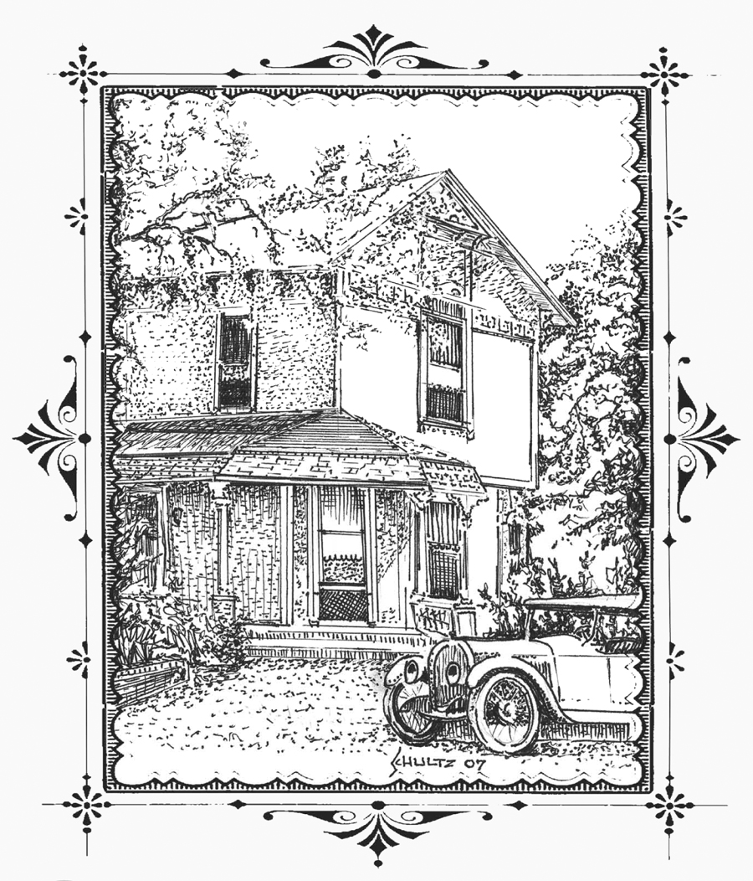
Martinez Historical Society Home Tour
“Pictures in time”
Save the date: Saturday, Oct. 13, 2012 10:00-4:00
8 Historic Homes, The Shell Clubhouse, The Martinez Museum,
The John Muir House and Adobe, Nature’s Way Doll Centre
Entertainment, Crafts, Demonstrations. Shuttle Service.
Credit Card Tickets on Sale at www.martinezhometour2012.eventbrite.com
Or cash tickets at the downtown merchants listed on the back of this flyer
Please visit our website www.martinezhometour.com
or call Carolyn Duncan at 864-8457 for more information
All proceeds from this event
are used for the restoration
of the old Train Depot

Slide 2
Cash tickets on sale at:
Chars Flowers- Downtown Martinez
I’ve Been Framed- Downtown Martinez
Rumain’s Jewelry- Nob Hill Shopping Center
Bagel Street Café- Nob Hill Shopping Center
The UPS Store- The Lucky Shopping Center
Shell Martinez
Refinery
Shell Chemical
Company
Shell Western States
Credit Union
Please support our sponsors!

